Slide 1
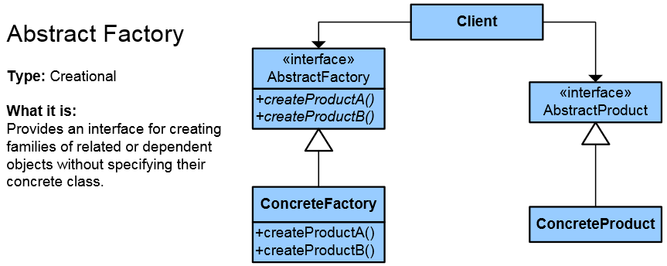
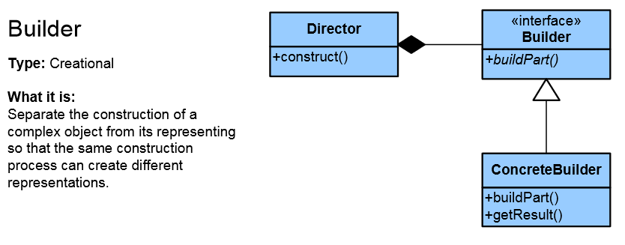
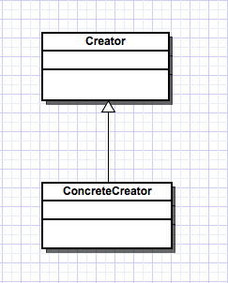
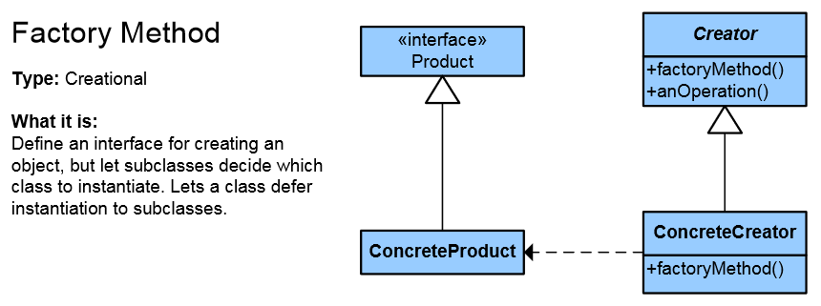
Creational Patterns
Deal with initializing and configuring classes and objects
High-Quality Code
Telerik Software Academy
http://academy.telerik.com

Slide 2
Creational Patterns
Deal with object creation mechanisms
Trying to create objects in a manner suitable to the situation
Composed of two dominant ideas
Encapsulating knowledge about which concrete classes the system uses
Hiding how instances of these concrete classes are created and combined

Slide 3
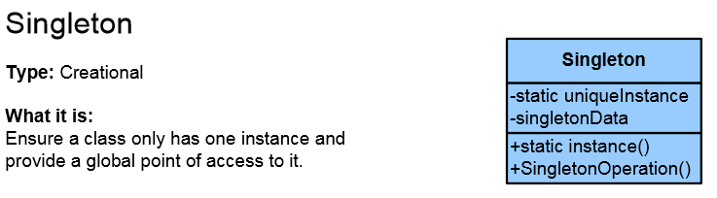
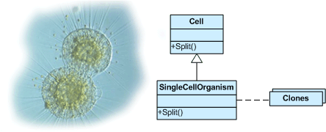
List of Creational Patterns
Singleton
Simple Factory
Factory Method
Abstract Factory
Builder
Prototype
Fluent Interface
Lazy initialization
Object Pool

Slide 4

Singleton

Slide 5
Singleton
The Singleton class is a class that is supposed to have only one (single) instance
Access window manager / file system / console
Access global application logger / DC / Mapper
Sometimes Singleton is wrongly thought of as a global variable – it is not!
Possible problems:
Lazy loading (created when first needed)
Thread-safe
References: C# in depth, MSDN, SourceMaking

Slide 6
Singleton (Structure)
public class Singleton {
private static Singleton instance;
// Note: Constructor is 'protected' or 'private'
protected Singleton() { }
public static Singleton Instance() { // Can be property
// Use 'Lazy initialization'
if (instance == null) {
instance = new Singleton();
}
return instance;
}
} // This implementation is not thread-safe!

Slide 7
Singleton (Thread-safe – lock)
public sealed class SingletonThreadSafe {
private static volatile SingletonThreadSafe instance;
// volatile modifier is used to show that the variable
// will be accessed by multiple threads concurrently.
private static object syncLock = new object();
private SingletonThreadSafe() { }
public static SingletonThreadSafe Instance {
get {
if (instance == null) {
lock (syncLock) {
if (instance == null) {
instance = new SingletonThreadSafe();
}
}
} // This doesn't work in Java 1.4 and earlier!
return instance;
}
}
}

Slide 8
Singleton (Thread-safe – nested)
public sealed class Singleton {
private Singleton() { }
public static Singleton Instance {
get {
return Nested.Instance;
}
}
private class Nested {
// Explicit static constructor to tell C# compiler
// not to mark type as beforefieldinit
// which will initialize the fields (Instance)
// just before their first use (not earlier)
static Nested() { }
internal static readonly Singleton Instance =
new Singleton();
}
}

Slide 9
Singleton (Thread-safe – Lazy<>)
public sealed class Singleton
{
private static readonly Lazy<Singleton> lazy =
new Lazy<Singleton>(
() => new Singleton());
public static Singleton Instance {
get {
return lazy.Value;
}
}
private Singleton()
{
}
}

Slide 10
Consequences of Singleton Use
Default (not thread-safe) implementation should not be used in multi-threaded environments (e.g. ASP.NET)
Singleton introduces tight coupling among collaborating classes
Singletons are difficult to test
Violates SRP by merging 2 responsibilities: managing object lifetime and the type itself
Inversion of control container can be responsible go managing object lifetime

Slide 11

Factories
Simple Factory, Factory Method and Abstract Factory

Slide 12
Simple Factory
Encapsulates object creation logic
If we are making specific class selection logic changes, we make them in one place
We can hide complex object creation
This is not a real Pattern
This is the preparation for the real Pattern
It is used quite often
Each time we add new type we need to modify the simple factory code

Slide 13
Simple Factory Demo Example
// Parameter can be string (e.g. from configuration file)
public Coffee GetCoffee(CoffeeType coffeeType)
{
// Can also be implemented using dictionary
switch (coffeeType)
{
case CoffeeType.Regular:
// Can be subtype of Coffee
return new Coffee(0, 150);
case CoffeeType.Double:
return new Coffee(0, 200);
case CoffeeType.Cappuccino:
return new Coffee(100, 100);
case CoffeeType.Macchiato:
return new Coffee(200, 100);
default:
throw new ArgumentException();
}
}

Slide 14
Factory Method
Objects are created by separate method(s)
Produces objects as normal factory
Adds an interface to the simple factory
Add new factories and classes without breaking Open/Closed Principle

Slide 15
Factory Method – Example
abstract class Document
{
private List<Page> _pages = new List<Page>();
public Document() { this.CreatePages(); }
public List<Page> Pages { get { return _pages; } }
public abstract void CreatePages();
}
class CV : Document
{
public override void CreatePages() {
Pages.Add(new SkillsPage(), new BioPage()); // ...
}
}
class Report : Document
{
public override void CreatePages() {
Pages.Add(new ResultsPage, SummaryPage()); // ...
}
}

Slide 16
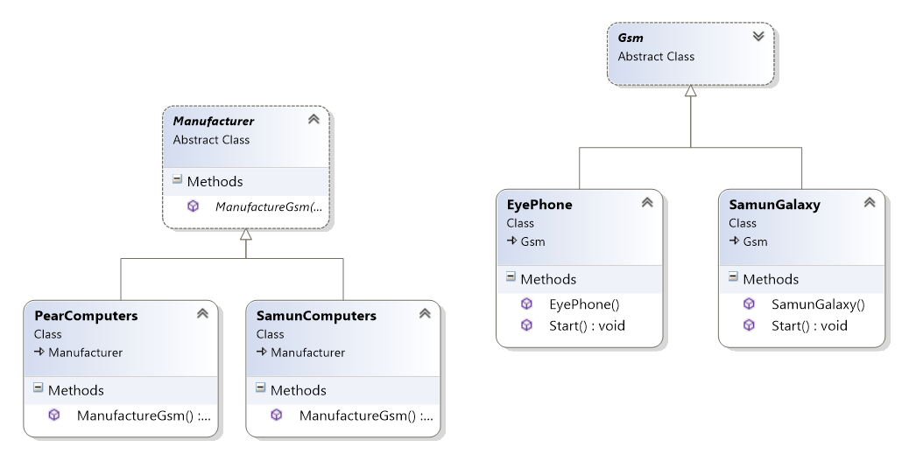
Factory Method Demo Example
Inheritance hierarchy gets deeper with coupling between concrete factories and classes

Slide 17
Abstract Factory
Abstraction in object creation
Create a family of related objects
The Abstract Factory Pattern defines interface for creating sets of linked objects
Without knowing their concrete classes
Used in systems that are frequently changed
Provides flexible mechanism for replacement of different sets
Notes:
Множество – йерархия, библиотека от класове, някаква съвкупност от свързани, зависими обекти
Множеството може ли да е само един обект?

Slide 18
Abstract Factory – Example
abstract class ContinentFactory { // AbstractFactory
public abstract Herbivore CreateHerbivore();
public abstract Carnivore CreateCarnivore();
}
class AfricaFactory : ContinentFactory {
public override Herbivore CreateHerbivore() {
return new Wildebeest();
}
public override Carnivore CreateCarnivore() {
return new Lion(); // Constructor can be internal
}
}
class AmericaFactory : ContinentFactory {
public override Herbivore CreateHerbivore() {
return new Bison();
}
public override Carnivore CreateCarnivore() {
return new Wolf();
}
}

Slide 19
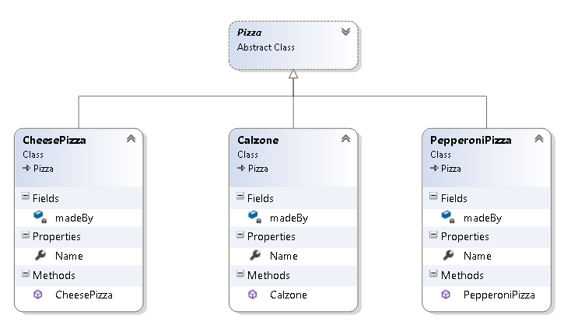
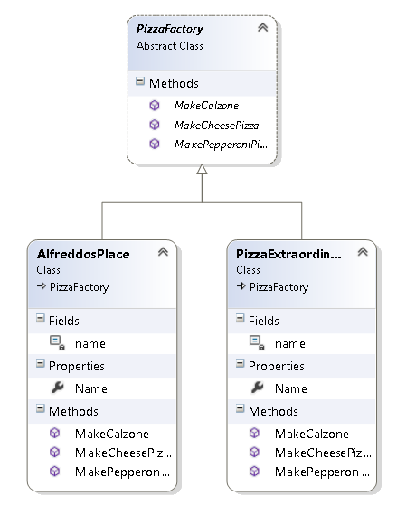
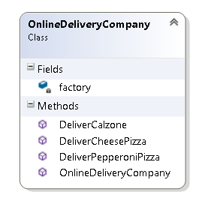
Abstract Factory Demo Example

Slide 20

Builder

Slide 21
The Builder Pattern
Separates the construction of a complex object (logic) from its representation (data) so that the same construction process can create different representations
Separation of logic (multistep) and data
Encapsulates the way an object is constructed
Solves 3 problems
Too many parameters
Order dependent
Different constructions
Example: Building a XML document
StringBuilder not using the builder pattern

Slide 22
The Builder Pattern (2)
Builder is used by Director
Builder is implemented by a concrete builder
Product is produced by the concrete builder
The client uses director and concrete builder to produce product
Puts the steps in the right order
Director
Defines the implementation
Defines the steps
Builder
Concrete Builder
Product (not different type, but different data)

Slide 23
Factories vs. Builder
Factory Method
Used when the factory can easily create the entire object within one method call
Common interface to group factories
Abstract Factory
Interface for creating families of related or dependent objects
Builder
When you need a lot of things to build an object
When construction is order-dependent

Slide 24

Prototype

Slide 25
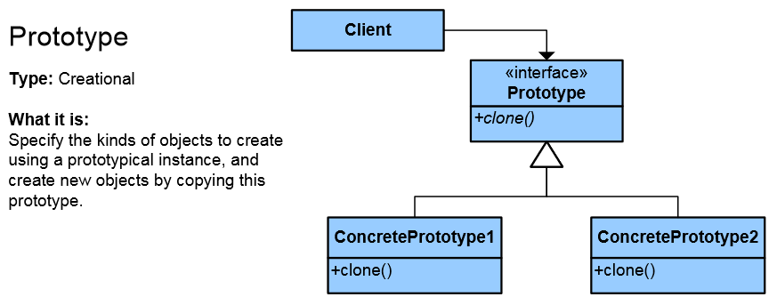
Prototype Pattern
Factory for cloning new instances from a prototype
Create new objects by copying prototype
Instead of using "new" keyword
ICloneable interface acts as Prototype

Slide 26
Prototype Pattern (2)
Benefits
It eliminates the (potentially expensive) overhead of initializing (construction) an object
Hides the complexities of making new instances from the client
Examples
Copy of web resource (instead of downloading it every time it is needed)
Getting copy of the current state of an object
Hiding constructors and allowing cloning
JavaScript is a prototypical language

Slide 27
Prototype Pattern – Example
public abstract class StormtrooperPrototype
{
public abstract Stormtrooper Clone();
}
public class Stormtrooper : StormtrooperPrototype
{
public override Stormtrooper Clone()
{
return this.MemberwiseClone() as Stormtrooper;
}
}
// Or using ICloneable in .NET
public class Stormtrooper : ICloneable
{
public object Clone()
{
return this.MemberwiseClone();
}
}

Slide 28

Other Creational Patterns
Fluent Interface, Lazy Initialization, Object Pool

Slide 29
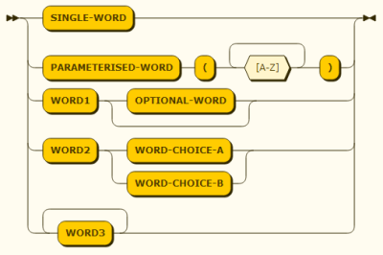
Fluent Interface
An implementation of an object-oriented API that aims to provide more readable code
Reduce syntactical noise
More clearly express what the code does
Implemented by using method cascading
Real world examples:
iostream library in C++
cout << "text" << 5;
KendoUI Wrappers
LINQ in .NET
Using extension methods

Slide 30

Lazy Initialization
Tactic of delaying the creation of an object, the calculation of a value, or some other expensive process until the first time it is needed
A.k.a. Virtual Proxy or Lazy Load pattern
Real-world examples
In ORMs navigation properties are lazy loaded (called dynamic proxies) (N+1)
When implementing Singleton
IoC containers
In .NET: Lazy<T> (value holder)

Slide 31
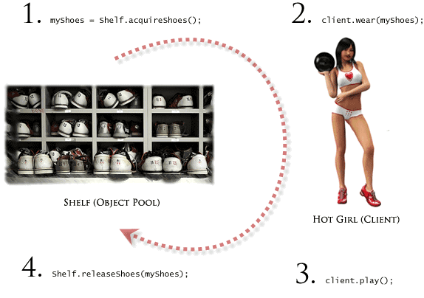
Object Pool
Avoid expensive acquisition and release of resources by recycling unused objects
Can offer a significant performance boost
Examples
Unity is moving objects instead of destroying and creating new ones
ADO.NET is using connection pooling because opening connection is expensive

Slide 32
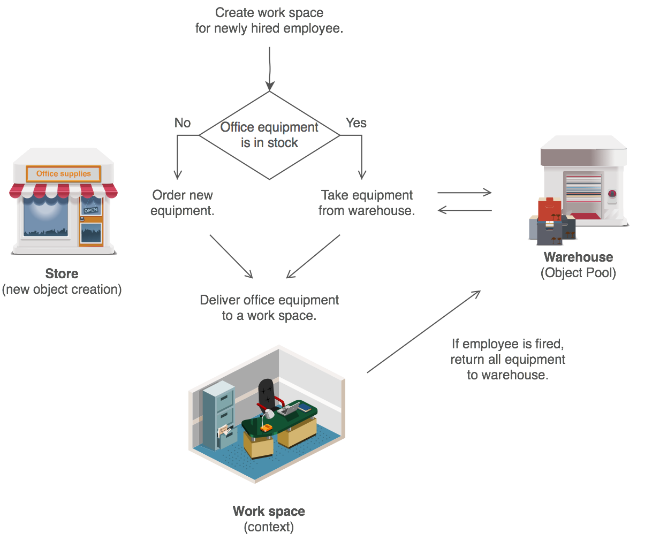
Object Pool – Demo

Slide 33
Creational Patterns
http://academy.telerik.com

Slide 34




Free Trainings @ Telerik Academy
C# Programming @ Telerik Academy
csharpfundamentals.telerik.com
Telerik Software Academy
academy.telerik.com
Telerik Academy @ Facebook
facebook.com/TelerikAcademy
Telerik Software Academy Forums
forums.academy.telerik.com

